Slide 1
Arizona Department of Child Safety Community Advisory Committee April 6, 2018

Slide 2
What is Quality?
Teachers who know how to work with infants toddlers and preschoolers
Limited teacher/child ratios and overall group size
Learning environments that nurture the emotional, social, language, and congnitive development of every child
Use of ongoing assessments
Family engagement and communication
A mechanism to measure quality such as Quality First, Head Start, or National Accreditation

Slide 3
Investments in early childhood education yield high returns

Slide 4
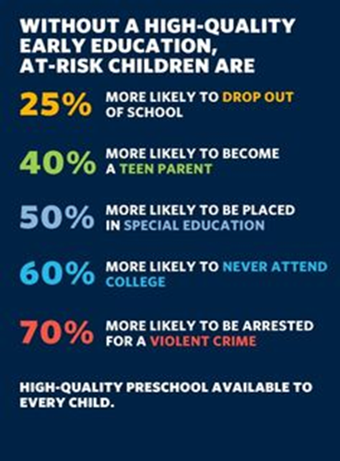
Investments in early childhood education yield high returns

Slide 5
Hb2449 – targets existing funds to increase access to quality child care for Arizona’s working families
Federal child care funds help some of our states most vulnerable children to access safe, reliable child care.
Currently, federal law requires states to spend a certain percentage of their total Child Care funds on services that improve quality in care.
This bill would require 33% of the quality dollars we spend to go to a tiered reimbursement system.
Quality First 4 Star Providers will receive a 10% reimbursement.
Quality First 5 Star Providers will receive a 20% reimbursement.
Nationally Accredited Providers will receive a 20% reimbursement.

Slide 6
Child care development block grant- (ccdbg)
On February 9th, 2018 Congress passed and the President signed a budget deal that included a funding increase to CCDBG for
$2,370,000,000!
What does this mean for Arizona?

Slide 7
Child care development block grant- (ccdbg) continued
$59 Million for Arizona!
It is expected that this increase will support the full implementation of the CCDBG Act as reauthorized in 2014. These funds could be used to do the following:
Implement programs to improve the quality and safety of child care programs, increasing provider reimbursement rates, and ensuring health and safety standards are met, meeting the needs of families with non-traditional work hours.
Improve Professional Development for the child care workforce.
Increase access to affordable, high quality child care to more low-income working families. (We still have a wait list)

Slide 8
Early childhood items also included In the federal budget
A $610 million increase for Head Start ($115 million of that for Early Head Start that will be used for Early Heart Expansion or Early Head Start/Child Care Partnerships)
A $35 million increase for CCAMPIS – this funds child care for mothers in college
A $20 million increase for 21st Centrury Community Learning Centers which supports after school programs
Flat funding for Preschool Development Grants at $250 million

